Slide 1
Hashing

Slide 2
Static Hashing
A bucket is a unit of storage containing one or more records (a bucket is typically a disk block).
In a hash file organization we obtain the bucket of a record directly from its search-key value using a hash function.
Hash function h is a function from the set of all search-key values K to the set of all bucket addresses B.
Hash function is used to locate records for access, insertion as well as deletion.
Records with different search-key values may be mapped to the same bucket; thus entire bucket has to be searched sequentially to locate a record.

Slide 3
Example of Hash File Organization
Hash file organization of instructor file, using dept_name as key
(See figure in next slide.)
There are 10 buckets,
The binary representation of the ith character is assumed to be the integer i.
The hash function returns the sum of the binary representations of the characters modulo 10
  E.g. h(Music) = 1 h(History) = 2
  h(Physics) = 3 h(Elec. Eng.) = 3

Slide 4

Example of Hash File Organization
Hash file organization of instructor file, using dept_name as key (see previous slide for details).

Slide 5
Hash Functions
Worst hash function maps all search-key values to the same bucket; this makes access time proportional to the number of search-key values in the file.
An ideal hash function is uniform, i.e., each bucket is assigned the same number of search-key values from the set of all possible values.
Ideal hash function is random, so each bucket will have the same number of records assigned to it irrespective of the actual distribution of search-key values in the file.
Typical hash functions perform computation on the internal binary representation of the search-key.
  For example, for a string search-key, the binary representations of all the characters in the string could be added and the sum modulo the number of buckets could be returned. .

Slide 6
Handling of Bucket Overflows
Bucket overflow can occur because of
  Insufficient buckets
  Skew in distribution of records. This can occur due to two reasons:
    multiple records have same search-key value
    chosen hash function produces non-uniform distribution of key values
Although the probability of bucket overflow can be reduced, it cannot be eliminated; it is handled by using overflow buckets.

Slide 7
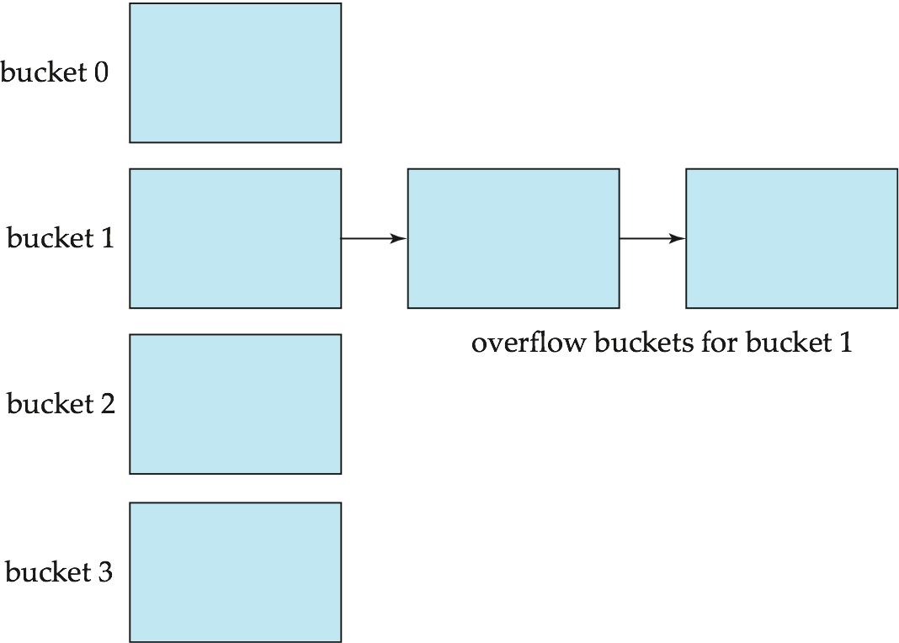
Handling of Bucket Overflows (Cont.)
Overflow chaining – the overflow buckets of a given bucket are chained together in a linked list.
Above scheme is called closed hashing.
  An alternative, called open hashing, which does not use overflow buckets, is not suitable for database applications.

Slide 8
Hash Indices
Hashing can be used not only for file organization, but also for index-structure creation.
A hash index organizes the search keys, with their associated record pointers, into a hash file structure.
Strictly speaking, hash indices are always secondary indices
  if the file itself is organized using hashing, a separate primary hash index on it using the same search-key is unnecessary.
  However, we use the term hash index to refer to both secondary index structures and hash organized files.

Slide 9
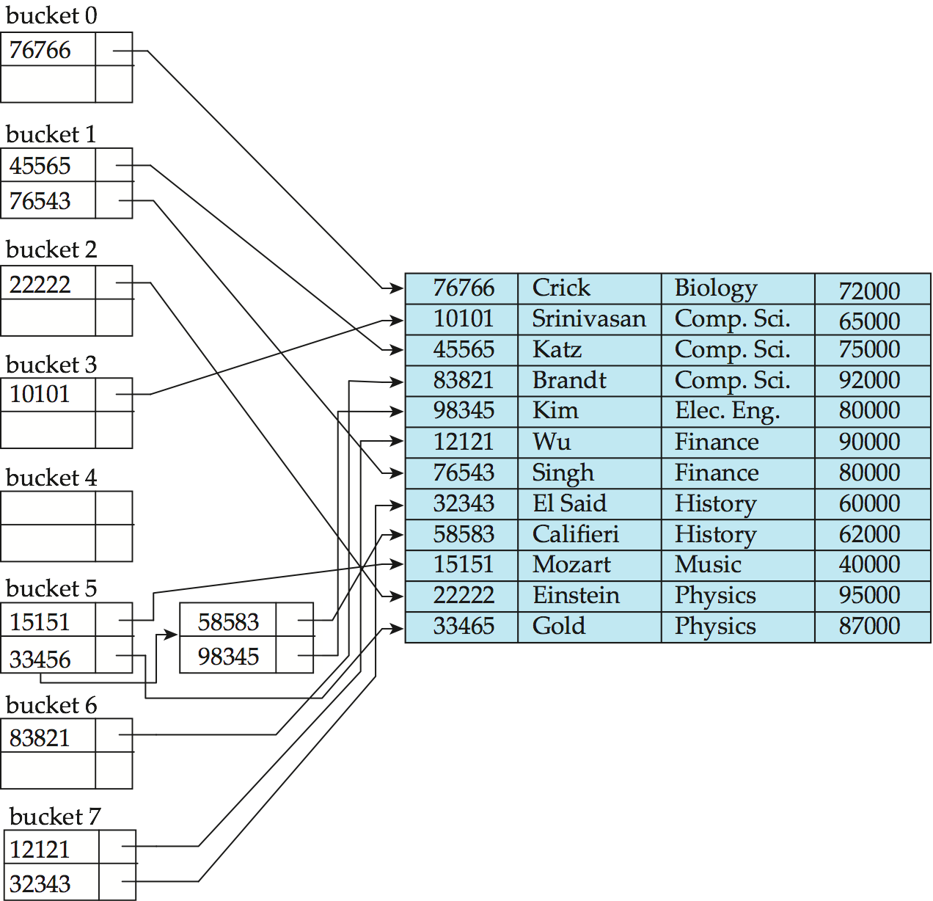
Example of Hash Index
hash index on instructor, on attribute ID

Slide 10
Deficiencies of Static Hashing
In static hashing, function h maps search-key values to a fixed set of B of bucket addresses. Databases grow or shrink with time.
  If initial number of buckets is too small, and file grows, performance will degrade due to too much overflows.
  If space is allocated for anticipated growth, a significant amount of space will be wasted initially (and buckets will be underfull).
  If database shrinks, again space will be wasted.
One solution: periodic re-organization of the file with a new hash function
  Expensive, disrupts normal operations
Better solution: allow the number of buckets to be modified dynamically.

Slide 11
Dynamic Hashing
Good for database that grows and shrinks in size
Allows the hash function to be modified dynamically
Extendable hashing – one form of dynamic hashing
  Hash function generates values over a large range — typically b-bit integers, with b = 32.
  At any time use only a prefix of the hash function to index into a table of bucket addresses.
  Let the length of the prefix be i bits, 0 ≤ i ≤ 32.
    Bucket address table size = 2^{i.} Initially i = 0
    Value of i grows and shrinks as the size of the database grows and shrinks.
  Multiple entries in the bucket address table may point to a bucket (why?)
  Thus, actual number of buckets is < 2^{i}
    The number of buckets also changes dynamically due to coalescing and splitting of buckets.

Slide 12
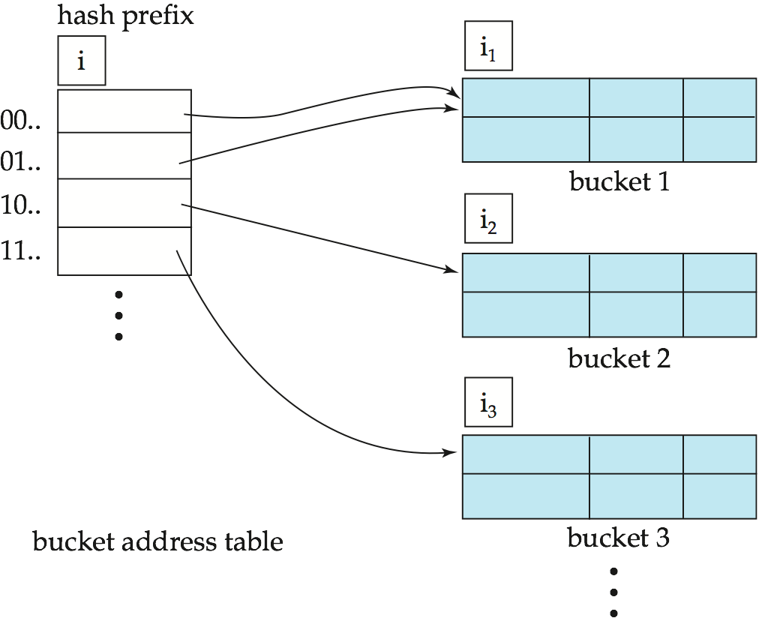
General Extendable Hash Structure
In this structure, i₂ = i₃ = i, whereas i₁ = i – 1 (see next slide for details)

Slide 13
Use of Extendable Hash Structure
Each bucket j stores a value i_{j}
  All the entries that point to the same bucket have the same values on the first i_{j} bits.
To locate the bucket containing search-key K_{j}:
  1. Compute h(K_{j}) = X
  2. Use the first i high order bits of X as a displacement into bucket address table, and follow the pointer to appropriate bucket
To insert a record with search-key value K_{j}
  follow same procedure as look-up and locate the bucket, say j.
  If there is room in the bucket j insert record in the bucket.
  Else the bucket must be split and insertion re-attempted (next slide.)
    Overflow buckets used instead in some cases (will see shortly)

Slide 14
Insertion in Extendable Hash Structure (Cont)
To split a bucket j when inserting record with search-key value K_{j}:
If i > i_{j} (more than one pointer to bucket j)
  allocate a new bucket z, and set i_{j} = i_{z} = (i_{j} + 1)
  Update the second half of the bucket address table entries originally pointing to j, to point to z
  remove each record in bucket j and reinsert (in j or z)
  recompute new bucket for K_{j} and insert record in the bucket (further splitting is required if the bucket is still full)
If i = i_{j} (only one pointer to bucket j)
  If i reaches some limit b, or too many splits have happened in this insertion, create an overflow bucket
  Else
    increment i and double the size of the bucket address table.
    replace each entry in the table by two entries that point to the same bucket.
    recompute new bucket address table entry for K_{j}
    Now i > i_{j} so use the first case above.

Slide 15
Deletion in Extendable Hash Structure
To delete a key value,
  locate it in its bucket and remove it.
  The bucket itself can be removed if it becomes empty (with appropriate updates to the bucket address table).
  Coalescing of buckets can be done (can coalesce only with a “buddy” bucket having same value of i_{j} and same i_{j} –1 prefix, if it is present)
  Decreasing bucket address table size is also possible
    Note: decreasing bucket address table size is an expensive operation and should be done only if number of buckets becomes much smaller than the size of the table

Slide 16
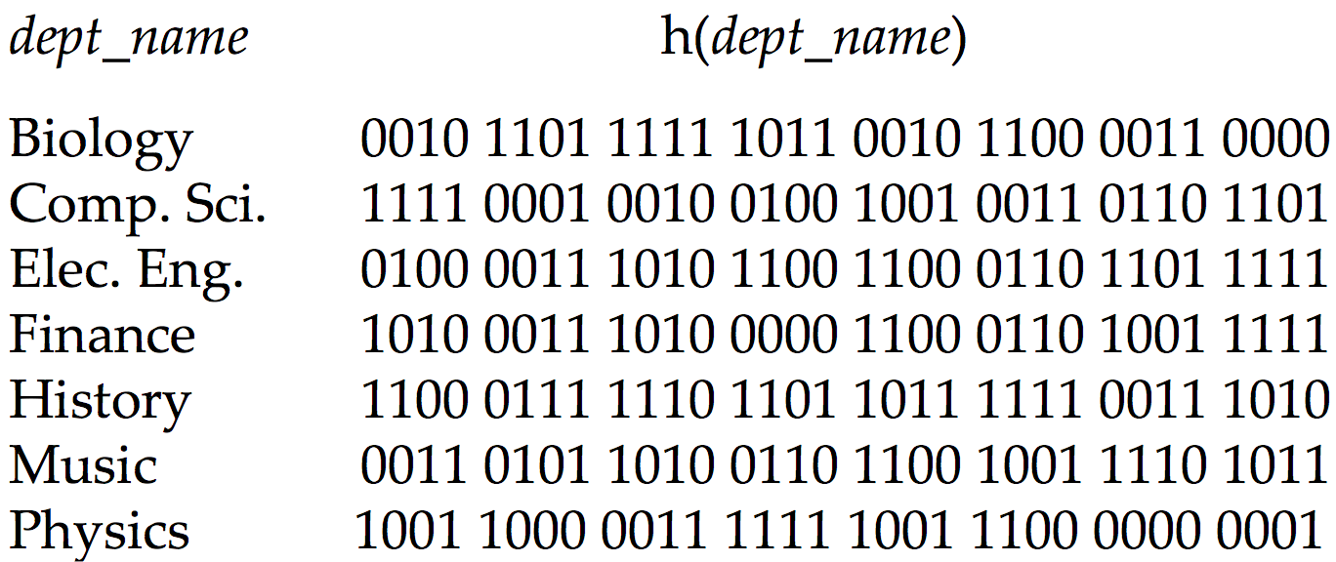
Use of Extendable Hash Structure: Example

Slide 17
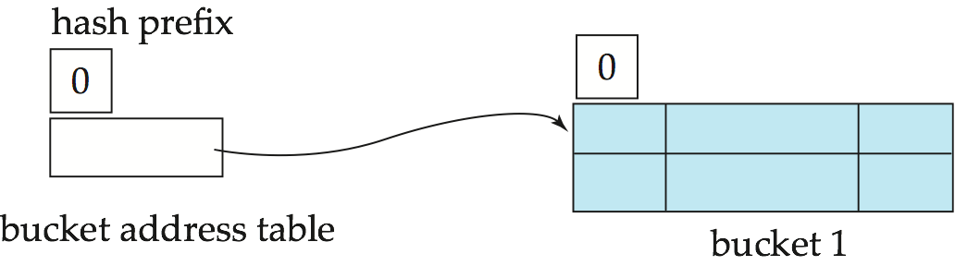
Example (Cont.)
Initial Hash structure; bucket size = 2

Slide 18
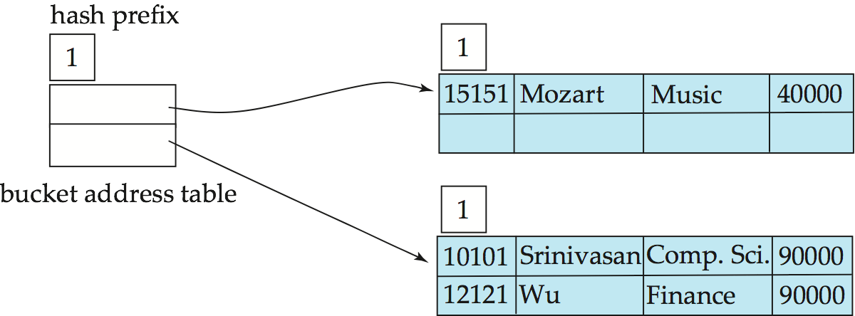
Example (Cont.)
Hash structure after insertion of “Mozart”, “Srinivasan”,
and “Wu” records

Slide 19
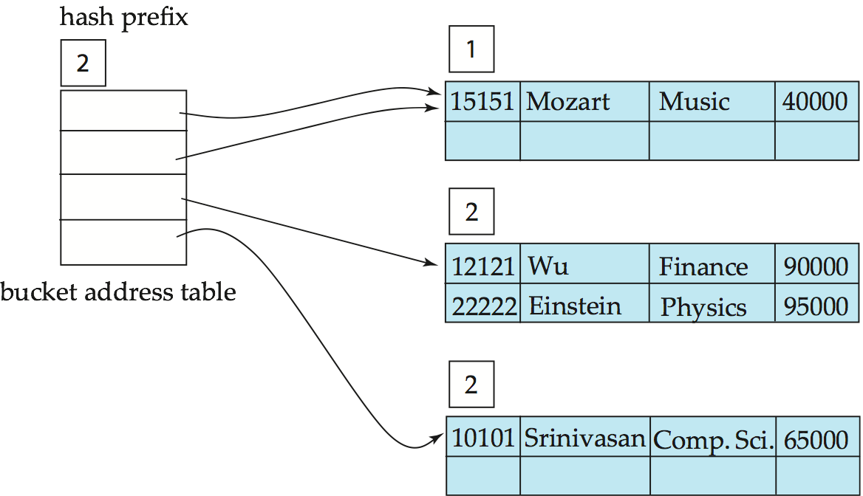
Example (Cont.)
Hash structure after insertion of Einstein record

Slide 20
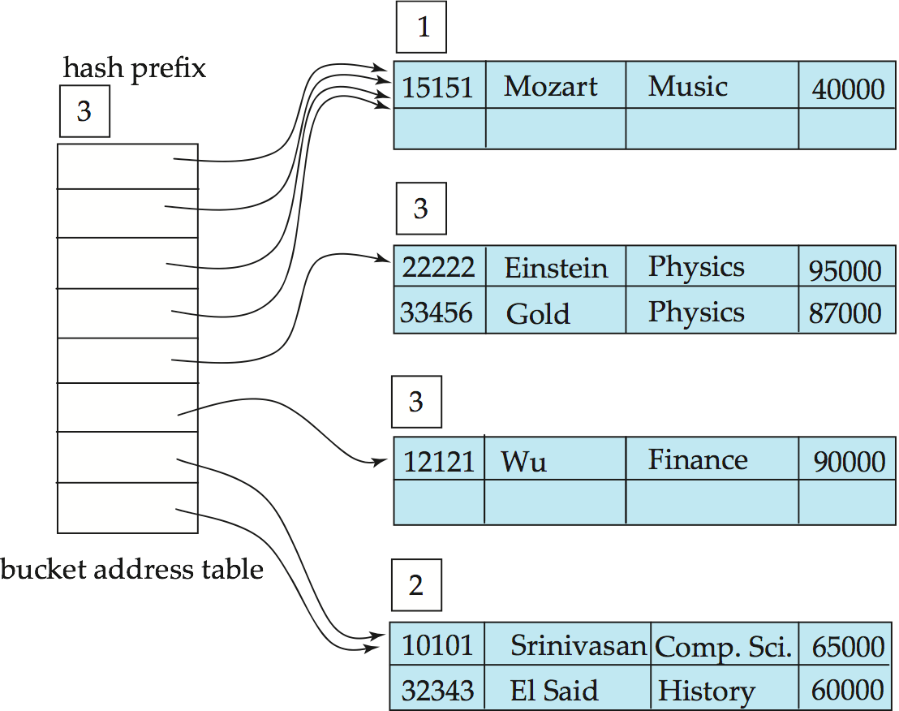
Example (Cont.)
Hash structure after insertion of Gold and El Said records

Slide 21
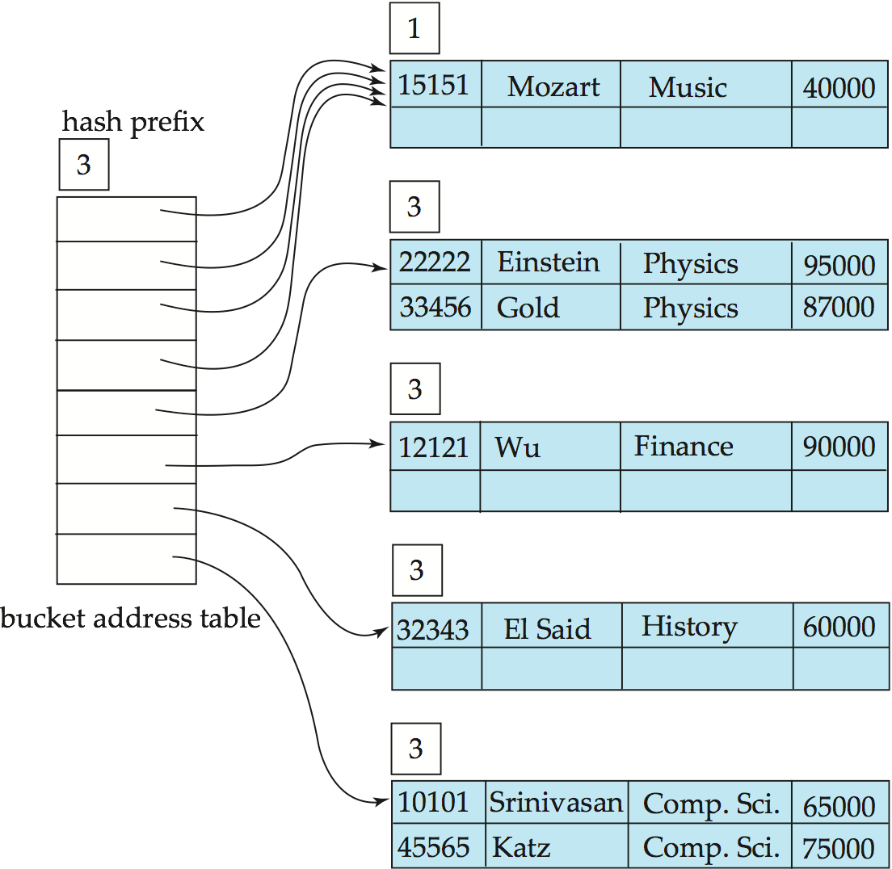
Example (Cont.)
Hash structure after insertion of Katz record

Slide 22
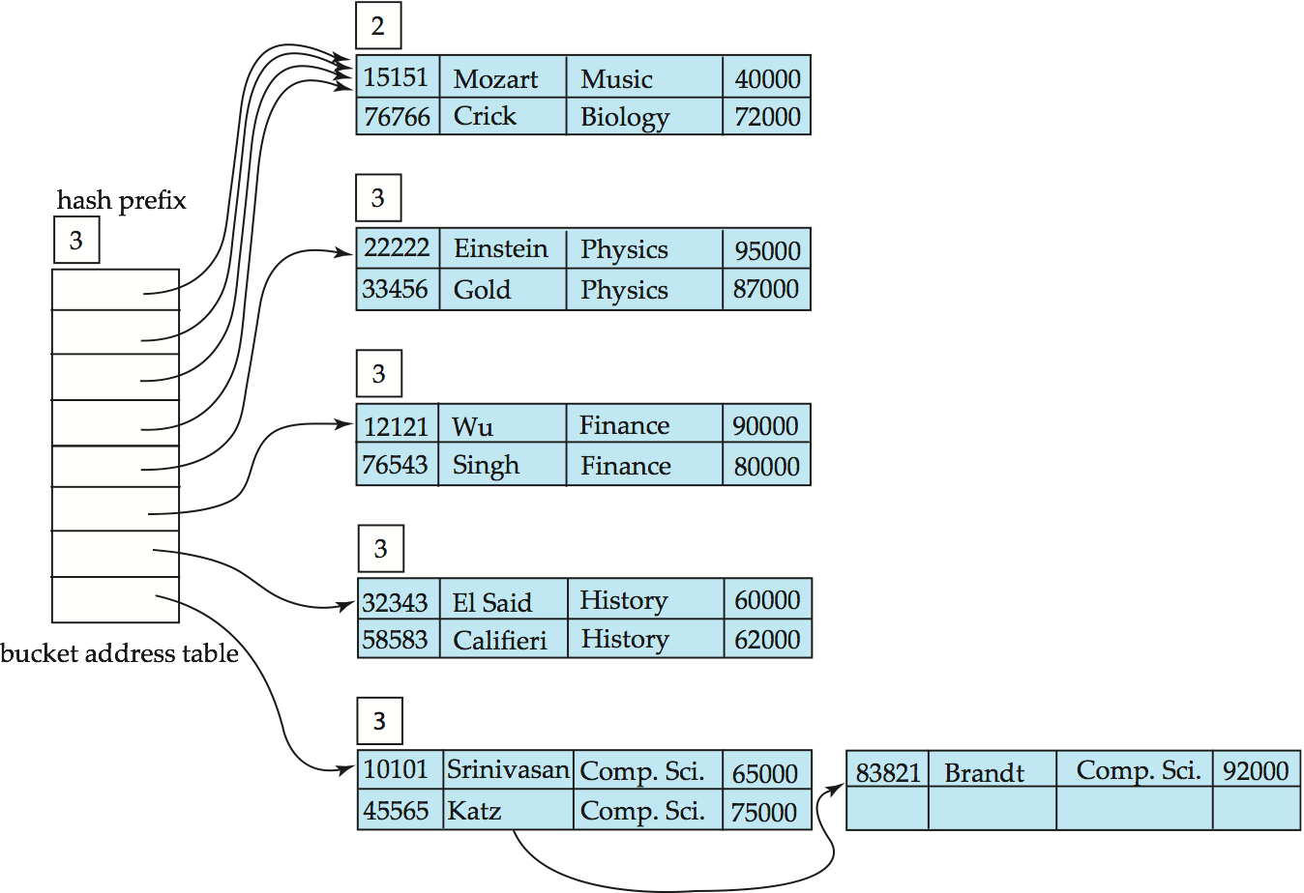
Example (Cont.)
And after insertion of
eleven records

Slide 23
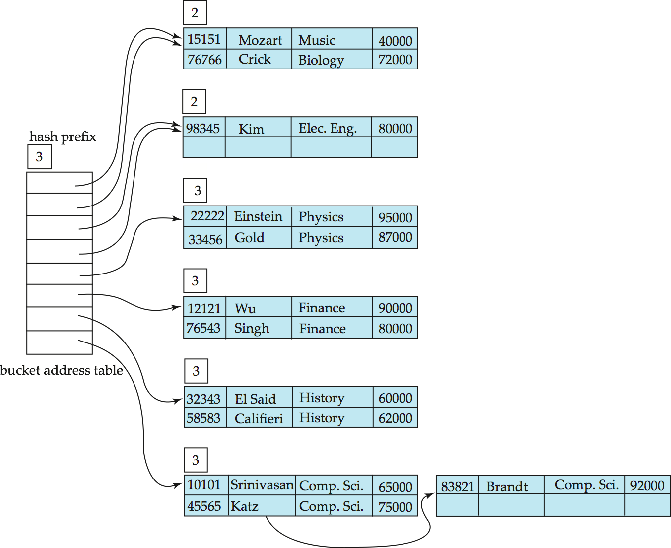
Example (Cont.)
And after insertion of
Kim record in previous
hash structure

Slide 24
Extendable Hashing vs. Other Schemes
Benefits of extendable hashing:
  Hash performance does not degrade with growth of file
  Minimal space overhead
Disadvantages of extendable hashing
  Extra level of indirection to find desired record
  Bucket address table may itself become very big (larger than memory)
    Cannot allocate very large contiguous areas on disk either
    Solution: B⁺-tree structure to locate desired record in bucket address table
  Changing size of bucket address table is an expensive operation
Linear hashing is an alternative mechanism
  Allows incremental growth of its directory (equivalent to bucket address table)
  At the cost of more bucket overflows

Slide 25
Comparison of Ordered Indexing and Hashing
Cost of periodic re-organization
Relative frequency of insertions and deletions
Is it desirable to optimize average access time at the expense of worst-case access time?
Expected type of queries:
  Hashing is generally better at retrieving records having a specified value of the key.
  If range queries are common, ordered indices are to be preferred
In practice:
  PostgreSQL supports hash indices, but discourages use due to poor performance
  Oracle supports static hash organization, but not hash indices
  SQLServer supports only B⁺-trees

Slide 26
Bitmap Indices
Bitmap indices are a special type of index designed for efficient querying on multiple keys
Records in a relation are assumed to be numbered sequentially from, say, 0
  Given a number n it must be easy to retrieve record n
    Particularly easy if records are of fixed size
Applicable on attributes that take on a relatively small number of distinct values
  E.g. gender, country, state, …
  E.g. income-level (income broken up into a small number of levels such as 0-9999, 10000-19999, 20000-50000, 50000- infinity)
A bitmap is simply an array of bits

Slide 27
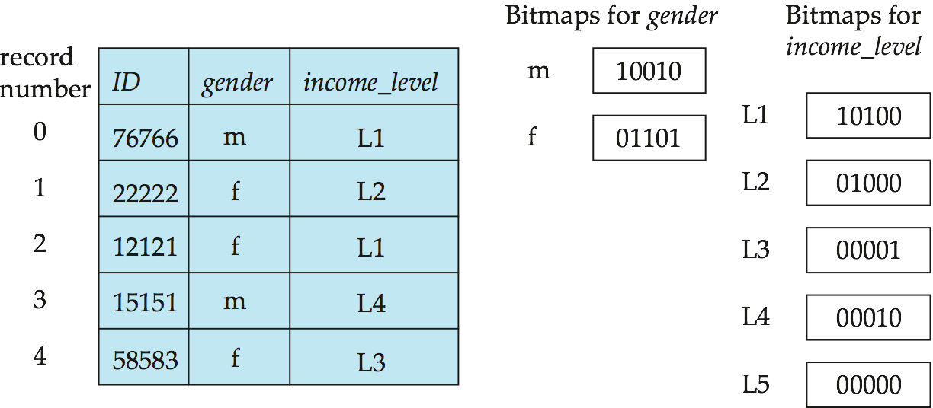
Bitmap Indices (Cont.)
In its simplest form a bitmap index on an attribute has a bitmap for each value of the attribute
  Bitmap has as many bits as records
  In a bitmap for value v, the bit for a record is 1 if the record has the value v for the attribute, and is 0 otherwise

Slide 28
Bitmap Indices (Cont.)
Bitmap indices are useful for queries on multiple attributes
  not particularly useful for single attribute queries
Queries are answered using bitmap operations
  Intersection (and)
  Union (or)
  Complementation (not)
Each operation takes two bitmaps of the same size and applies the operation on corresponding bits to get the result bitmap
  E.g. 100110 AND 110011 = 100010
  100110 OR 110011 = 110111
  NOT 100110 = 011001
  Males with income level L1: 10010 AND 10100 = 10000
    Can then retrieve required tuples.
    Counting number of matching tuples is even faster

Slide 29
Bitmap Indices (Cont.)
Bitmap indices generally very small compared with relation size
  E.g. if record is 100 bytes, space for a single bitmap is 1/800 of space used by relation.
    If number of distinct attribute values is 8, bitmap is only 1% of relation size
Deletion needs to be handled properly
  Existence bitmap to note if there is a valid record at a record location
  Needed for complementation
    not(A=v): (NOT bitmap-A-v) AND ExistenceBitmap
Should keep bitmaps for all values, even null value
  To correctly handle SQL null semantics for NOT(A=v):
    intersect above result with (NOT bitmap-A-Null)

Slide 30
Efficient Implementation of Bitmap Operations
Bitmaps are packed into words; a single word and (a basic CPU instruction) computes and of 32 or 64 bits at once
  E.g. 1-million-bit maps can be and-ed with just 31,250 instruction
Counting number of 1s can be done fast by a trick:
  Use each byte to index into a precomputed array of 256 elements each storing the count of 1s in the binary representation
    Can use pairs of bytes to speed up further at a higher memory cost
  Add up the retrieved counts
Bitmaps can be used instead of Tuple-ID lists at leaf levels of
B⁺-trees, for values that have a large number of matching records
  Worthwhile if > 1/64 of the records have that value, assuming a tuple-id is 64 bits
  Above technique merges benefits of bitmap and B⁺-tree indices

Slide 31
Index Definition in SQL
Create an index
  create index <index-name> on <relation-name>
  (<attribute-list>)
  E.g.: create index b-index on branch(branch_name)
Use create unique index to indirectly specify and enforce the condition that the search key is a candidate key is a candidate key.
  Not really required if SQL unique integrity constraint is supported
To drop an index
  drop index <index-name>
Most database systems allow specification of type of index, and clustering.

Slide 32
End of Chapter

Slide 33
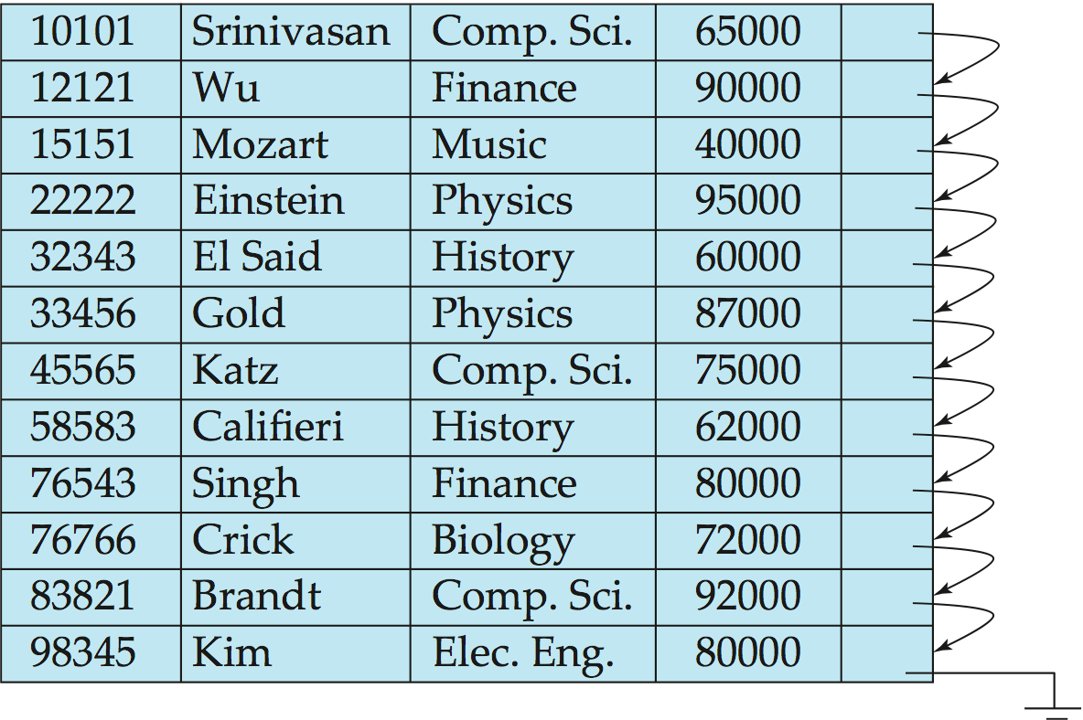
Figure 11.01

Slide 34
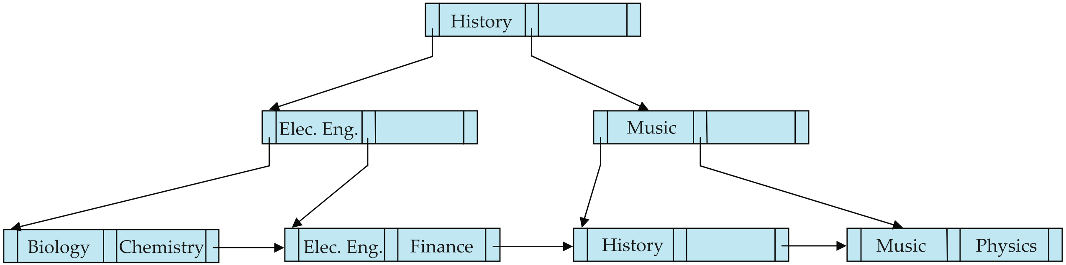
Figure 11.15

Slide 35
Partitioned Hashing
Hash values are split into segments that depend on each attribute of the search-key.
(A₁, A₂, . . . , A_{n}) for n attribute search-key
Example: n = 2, for customer, search-key being
(customer-street, customer-city)
search-key value hash value
(Main, Harrison) 101 111
(Main, Brooklyn) 101 001
(Park, Palo Alto) 010 010
(Spring, Brooklyn) 001 001
(Alma, Palo Alto) 110 010
To answer equality query on single attribute, need to look up multiple buckets. Similar in effect to grid files.

Slide 36
Grid Files
Structure used to speed the processing of general multiple search-key queries involving one or more comparison operators.
The grid file has a single grid array and one linear scale for each search-key attribute. The grid array has number of dimensions equal to number of search-key attributes.
Multiple cells of grid array can point to same bucket
To find the bucket for a search-key value, locate the row and column of its cell using the linear scales and follow pointer

Slide 37
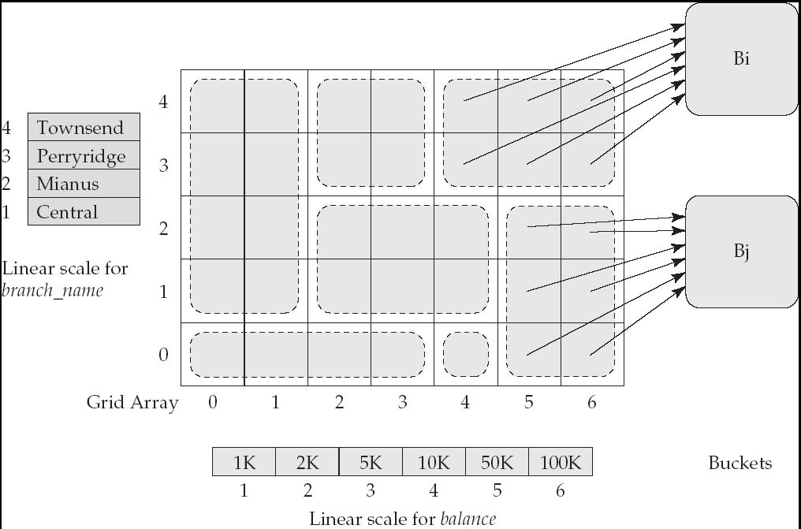
Example Grid File for account

Slide 38
Queries on a Grid File
A grid file on two attributes A and B can handle queries of all following forms with reasonable efficiency
  (a₁ ≤ A ≤ a₂)
  (b₁ ≤ B ≤ b₂)
  (a₁ ≤ A ≤ a₂ ∧ b₁ ≤ B ≤ b₂),.
E.g., to answer (a₁ ≤ A ≤ a₂ ∧ b₁ ≤ B ≤ b₂), use linear scales to find corresponding candidate grid array cells, and look up all the buckets pointed to from those cells.

Slide 39
Grid Files (Cont.)
During insertion, if a bucket becomes full, new bucket can be created if more than one cell points to it.
  Idea similar to extendable hashing, but on multiple dimensions
  If only one cell points to it, either an overflow bucket must be created or the grid size must be increased
Linear scales must be chosen to uniformly distribute records across cells.
  Otherwise there will be too many overflow buckets.
Periodic re-organization to increase grid size will help.
  But reorganization can be very expensive.
Space overhead of grid array can be high.
R-trees (Chapter 23) are an alternative

